Slide 1

Chapter 2 – Using Objects

Slide 2
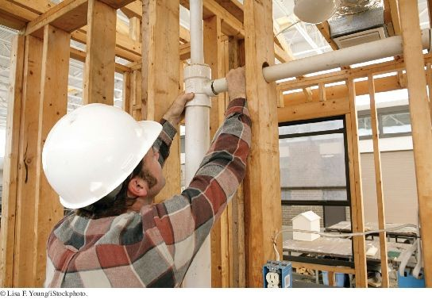
Chapter Goals
To learn about variables
To understand the concepts of classes and objects To be able to call methods
To learn about arguments and return values To be able to browse the API documentation
To implement test programs
To understand the difference between objects and object references To write programs that display simple shapes

Slide 3
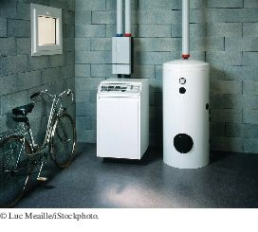
Objects and Classes
Each part a home builder uses, such as a furnace or a water heater, fulfills a particular function. Similarly, you build programs from objects, each of which has a particular behavior.
In Java, you build programs for objects.
Each object has certain behaviors.
You can manipulate the object to get certain effects.

Slide 4
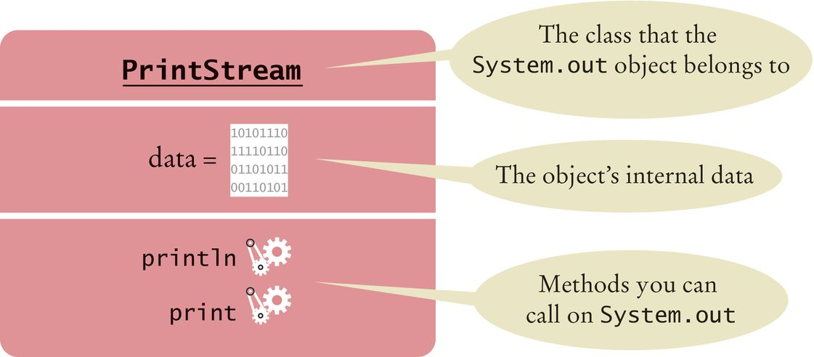
Using Objects
Object: an entity in your program that you can manipulate by calling one or more of its methods.
Method: consists of a sequence of instructions that can access the data of an object.
You do not know what the instructions are You do know that the behavior is well defined
System.out has a println method
You do not know how it works
What is important is that it does the work you request of it
Figure 1 Representation of the System.out Object

Slide 5
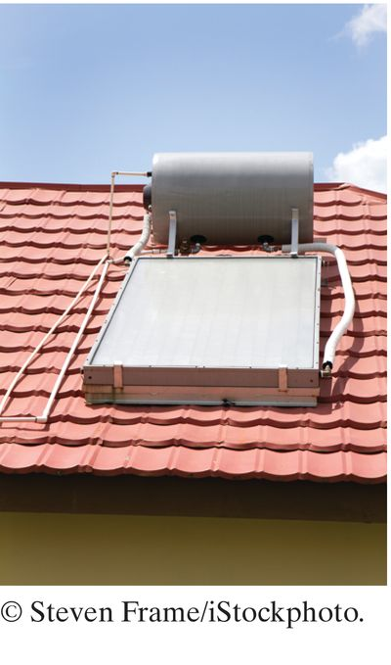
Using Objects
You can think of a water heater as an object that can carry out the "get hot water" method. When you call that method to enjoy a hot shower, you don't care whether the water heater uses gas or solar power.

Slide 6
Classes
A class describes a set of objects with the same behavior.
Some string objects
"Hello World" "Goodbye" "Mississippi"
You can invoke the same methods on all strings.
System.out is a member of the PrintStream class that writes to the console window.
You can construct other objects of PrintStream class that write to different destinations.
All PrintStream objects have methods println and print.

Slide 7

Classes
Objects of the PrintStream class have a completely different behavior than the objects of the String class.
Different classes have different responsibilities
A string knows about the letters that it contains
A string doesn't know how to send itself to a console window or file.
All objects of the Window class share the same behavior.

Slide 8
Self Check 2.1
In Java, objects are grouped into classes according to their behavior. Would a window object and a water heater object belong to the same class or to different classes? Why?
Answer: Objects with the same behavior belong to the same class. A window lets in light while protecting a room from the outside wind and heat or cold. A water heater has completely different behavior. It heats water. They belong to different classes.

Slide 9
Self Check 2.2
Some light bulbs use a glowing filament, others use a fluorescent gas. If you consider a light bulb a Java object with an "illuminate" method, would you need to know which kind of bulb it is?
Answer: When one calls a method, one is not concerned with how it does its job. As long as a light bulb illuminates a room, it doesn't matter to the occupant how the photons are produced.

Slide 10
Self Check 2.3
What actually happens when you try to call the following?
"Hello, World".println(System.out);
Answer: When you compile the program, you get an error message that the String class doesn’t have a println method.

Slide 11
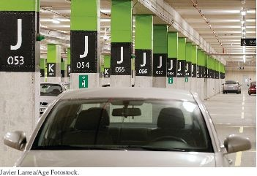
Variables
Use a variable to store a value that you want to use later To declare a variable named width
int width = 20;
Like a variable in a computer program, a parking space has an identifier and a contents.

Slide 12
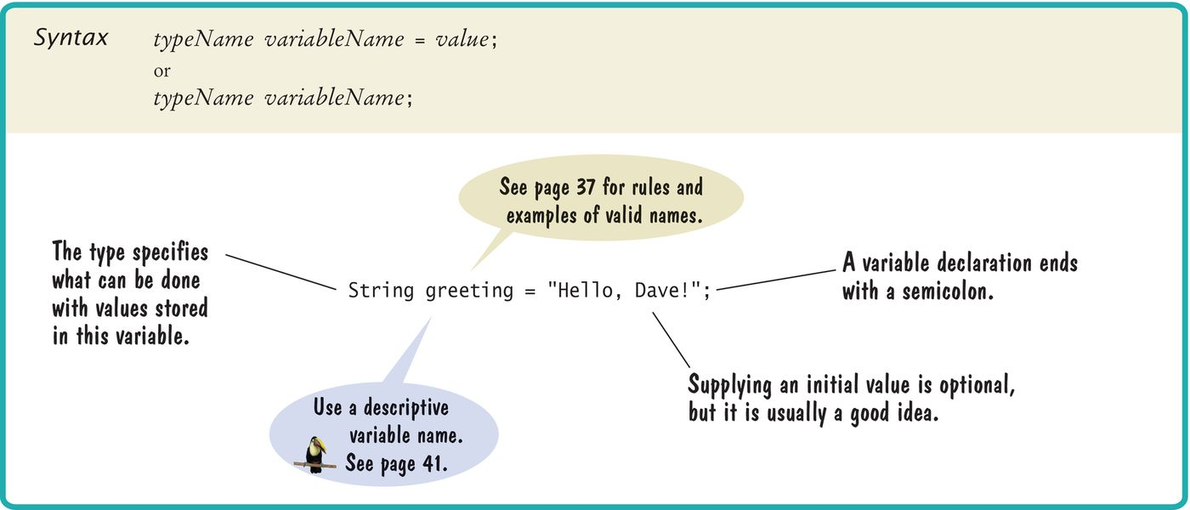
Syntax 2.1 Variable Declaration

Slide 13
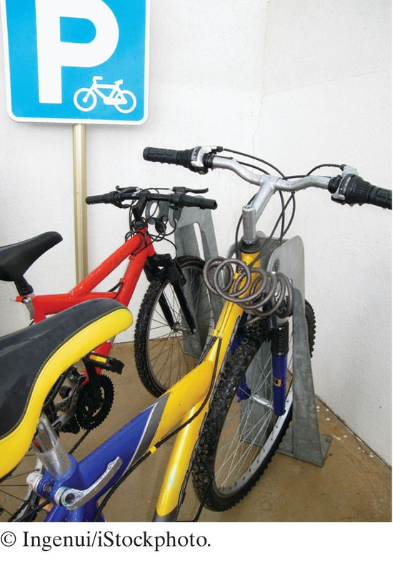
Variables
A variable is a storage location
Has a name and holds a value
When declaring a variable, you usually specify an initial value. When declaring a variable, you also specify the type of its values. Variable declaration: int width = 20:
width is the name
int is the type
20 is the initial value
Each parking space is suitable for a particular type of vehicle, just as each variable holds a value of a particular type.

Slide 14
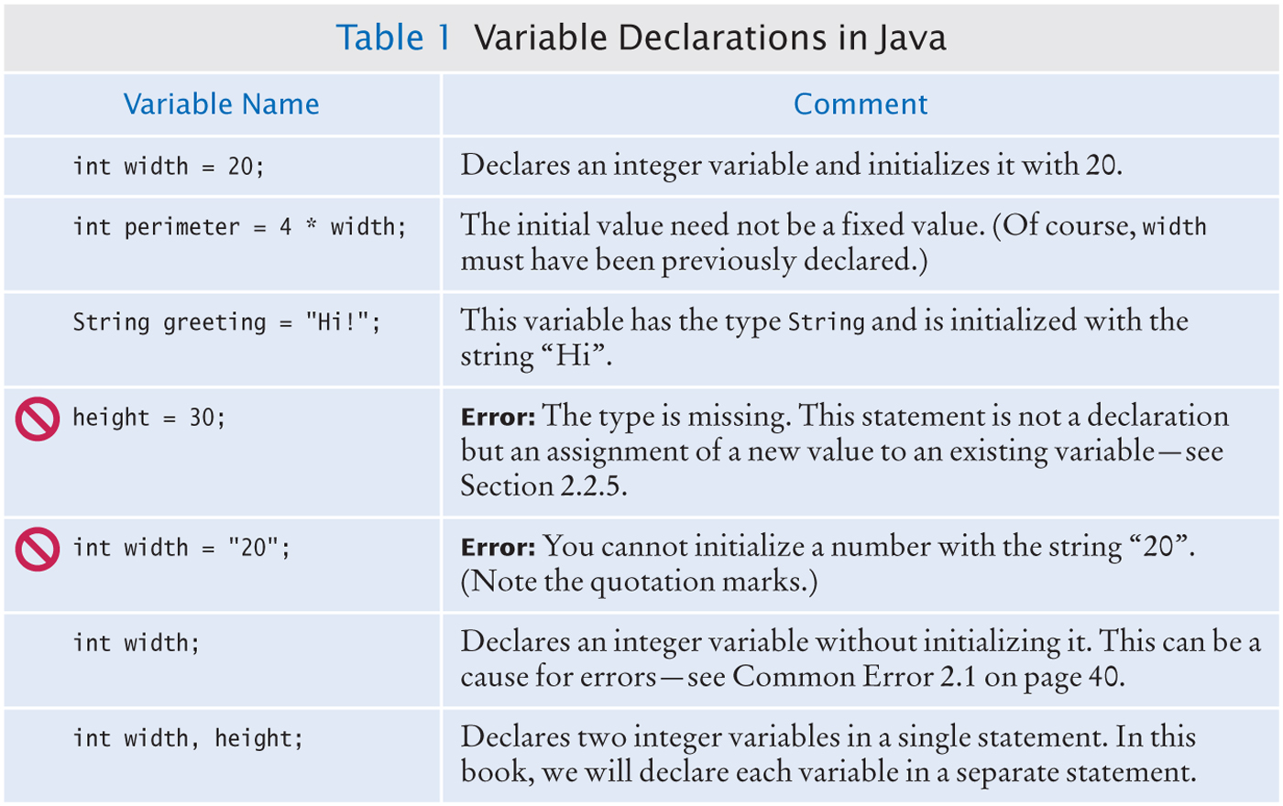
Variable Declarations

Slide 15
Types
Use the int type for numbers that cannot have a fractional part.
int width = 20;
Use the double type for floating point numbers.
double milesPerGallon = 22.5;
Numbers can be combined by arithmetic operators such as +, -, and *
Another type is String
String greeting = "Hello";
A type specifies the operations that can be carried out with its values.
You can multiply the value width holds by a number You can not multiply greetings by a number.

Slide 16
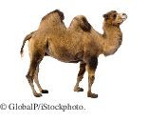
Names
Pick a name for a variable that describes its purpose. Rules for the names of variables, methods, and classes:
Must start with a letter or the underscore (_) character, and the remaining characters must be letters, numbers, or underscores.
Cannot use other symbols such as ? or % or a space
Use uppercase letters to denote word boundaries, as in milesPerGallon.
(Called camel case)
Names are case sensitive
You cannot use reserved words such as double or class
By Java convention:
variable names start with a lowercase letter. class names start with an uppercase letter.

Slide 17
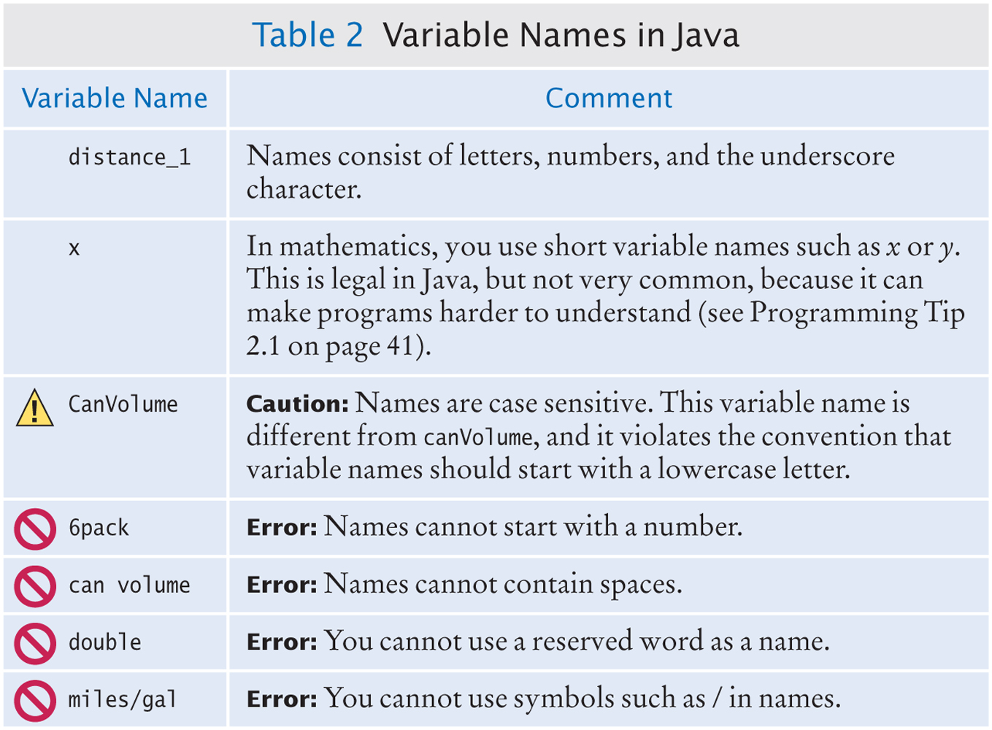
Variable Names in Java

Slide 18
Comments
Use comments to add explanations for humans who read your code.
double milesPerGallon = 33.8;
// The average fuel efficiency of new U.S. cars in 2011
The compiler does not process comments
It ignores everything from a // delimiter to the end of the line.
For longer comment, enclose it between /* and */ delimiters.
The compiler ignores these delimiters and everything in between.
Example of longer comments
/*
In most countries, fuel efficiency is measured in liters per hundred kilometer. Perhaps that is more useful—it tells you how much gas you need to purchase to drive a given distance. Here is the conversion formula.
*/
double fuelEfficiency = 235.214583 / milesPerGallon

Slide 19

Assignment
Use the assignment operator (=) to change the value of a variable.
You have the following variable declaration
int width = 10;
To change the value of the variable, assign the new value
width = 20;
Figure 2 Assigning a New Value to a Variable

Slide 20

Assignment
It is an error to use a variable that has never had a value assigned to it:
int height;
int width = height; // ERROR - uninitialized variable height
The compiler will complain about an "uninitialized variable"
Figure 3 An Uninitialized Variable
Remedy: assign a value to the variable before you use it.
int height = 20;
int width = height; // OK
All variables must be initialized before you access them.

Slide 21
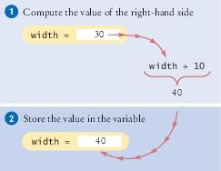
Assignment
The right-hand side of the = symbol can be a mathematical expression:
width = height + 10;
This means
compute the value of height + 10
store that value in the variable width
width = width + 10
The assignment operator = does not denote mathematical equality.
Figure 4 Executing the Statement width = width + 10

Slide 22
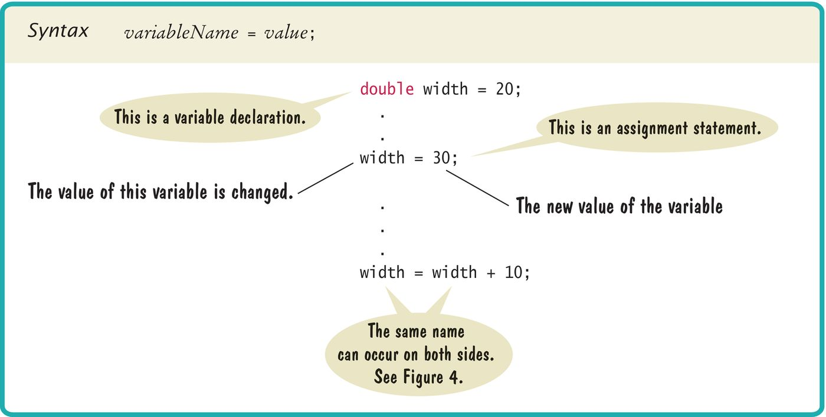
Syntax 2.2 Assignment

Slide 23
Self Check 2.4
What is wrong with the following variable declaration?
int miles per gallon = 39.4
Answer: There are three errors:
You cannot have spaces in variable names.
The variable type should be double because it holds a fractional value.
There is a semicolon missing at the end of the statement.

Slide 24
Self Check 2.5
Declare and initialize two variables, unitPrice and quantity, to contain the unit price of a single item and the number of items purchased. Use reasonable initial values.
Answer:
double unitPrice = 1.95; int quantity = 2;

Slide 25
Self Check 2.6
Use the variables declared in Self Check 4 to display the total purchase price.
Answer:
System.out.print("Total price: "); System.out.println(unitPrice * quantity);

Slide 26
Self Check 2.7
What are the types of the values 0 and "0"?
Answer: int and String

Slide 27
Self Check 2.8
Which number type would you use for storing the area of a circle?
Answer: double

Slide 28
Self Check 2.9
Which of the following are legal identifiers?
Greeting1 g
void 101dalmatians Hello, World
<greeting>
Answer: Only the first two are legal identifiers.

Slide 29
Self Check 2.10
Declare a variable to hold your name. Use camel case in the variable name.
Answer: String myName = "John Q. Public";

Slide 30
Self Check 2.11
Is 12 = 12 a valid expression in the Java language?
Answer: No, the left-hand side of the = operator must be a variable.

Slide 31
Self Check 2.12
How do you change the value of the greeting variable to "Hello, Nina!"?
Answer: greeting = "Hello, Nina!";
Note that
String greeting = "Hello, Nina!";
is not the right answer—that statement declares a new variable

Slide 32
Self Check 2.13
How would you explain assignment using the parking space analogy?
Answer: Assignment would occur when one car is replaced by another in the parking space.

Slide 33
Calling Methods
You use an object by calling its methods.
All objects of a given class share a common set of methods.
The PrintStream class provides methods for its objects such as:
println print
The String class provides methods that you can apply to all String
objects.
Example: length
String greeting = “Hello, World!”;
int numberOfCharacters = greeting.length();
Example: toUpperCase
String river = “Mississippi”;
String bigRiver = river.toUpperCase();

Slide 34

The Public Interface of a Class
The controls of a car form its public interface. The private implementation is under the hood.
The String class declares many other methods besides the length and
toUpperCase methods.
Collectively, the methods form the public interface of the class.
The public interface of a class specifies what you can do with its objects. The hidden implementation describes how these actions are carried out.

Slide 35
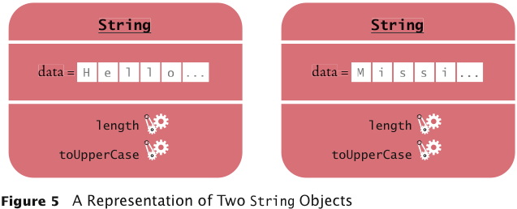
A Representation of Two String Objects
Each String object stores its own data.
Both objects support the same set of methods.
Those methods form the public interface
Public interface is specified by the String class.

Slide 36
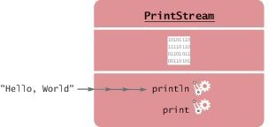
Method Arguments
Most methods require values that give details about the work that the method needs to do.
You must supply the string that should be printed when you call the println method.
The technical term for method inputs: arguments.
The string greeting is an argument of this method call:
System.out.println(greeting);
Figure 6 Passing an Argument to the println Method

Slide 37

Method Arguments
At this tailor shop, the customer's measurements and the fabric are the arguments of the sew method. The return value is the finished garment.

Slide 38
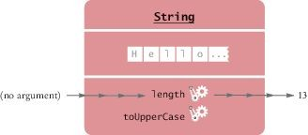
Method Arguments
Some methods require multiple arguments.
Other methods don't require any arguments at all.
Example: the length method of the String class
All the information that the length method requires to do its job is stored in the object
Figure 7 Invoking the length Method on a String Object

Slide 39
Return Values
Some methods carry out an action for you.
Example: println method
Other methods compute and return a value.
Example: the String length method
returns a value: the number of characters in the string.
You can store the return value in a variable:
int numberOfCharacters = greeting.length()
The return value of a method is a result that the method has computed.

Slide 40
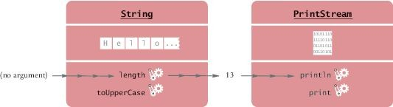
Return Values
You can also use the return value of one method as an argument of another method:
System.out.println(greeting.length());
The method call greeting.length() returns a value - the integer 13. The return value becomes an argument of the println method.
Figure 8 Passing the Result of a Method Call to Another Method

Slide 41
Return Values - replace method
Example: assume String river = "Mississippi";
Then the statement
river = river.replace("issipp", "our");
Constructs a new String by
Replacing all occurrences of "issipp" in"Mississippi" with "our"
Returns the constructed String object "Missouri" And saves the return value in the same variable
You could pass the return value to another method:
System.out.println(river.replace("issipp", "our"))

Slide 42
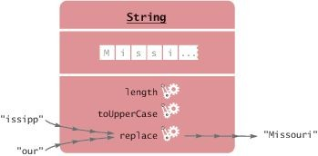
Return Value - replace method - Continued
The method call
river.replace("issipp", "our"))
Is invoked on a String object: "Mississippi" Has two arguments: the strings "issipp" and "our" Returns a value: the string "Missouri"
Figure 9 Calling the replace Method

Slide 43
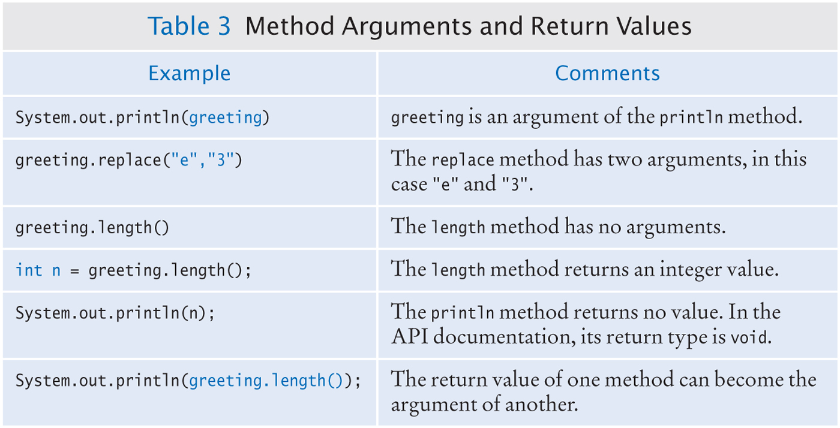
Method Arguments and Return Values

Slide 44
Method Declaration
To declare a method in a class, specify
The types of the arguments The return value
Example: public int length()
There are no arguments
The return value has the type int

Slide 45
Method Declaration - continued
Example: public String replace(String target, replacement)
Has two arguments, target and replacement
Both arguments have type String
The returned value is another string
String
Example: public void println(String
Has an argument of type String
No return value
Uses the keyword void
output)

Slide 46
Method Declaration
A class can declare two methods with the same name and different argument types.
The PrintStream class declares another println method
public void println(int output)
Used to print an integer value
The println name is overloaded because it refers to more than one method.

Slide 47
Self Check 2.14
How can you compute the length of the string "Mississippi"?
Answer: river.length() or "Mississippi".length()

Slide 48
Self Check 2.15
How can you print out the uppercase version of "Hello, World!"?
Answer: System.out.println(greeting.toUpperCase()); Or
System.out.println("Hello, World!".toUpperCase());

Slide 49
Self Check 2.16
Is it legal to call river.println()? Why or why not?
Answer: It is not legal. The variable river has type String. The
println method is not a method of the String class.

Slide 50
Self Check 2.17
What are the arguments in the method call river.replace("p", "s")?
Answer: The arguments are the strings "p" and "s".

Slide 51
Self Check 2.18
What is the result of the call river.replace("p", "s"), where river is "Mississippi"?
Answer: "Missississi"

Slide 52
Self Check 2.19
What is the result of the call greeting.replace("World", "Dave").length(), where
greeting is "Hello, World!"?
Answer: 12

Slide 53
Self Check 2.20
How is the toUpperCase method declared in the String class?
Answer: As public String toUpperCase(), with no argument and return type String.

Slide 54
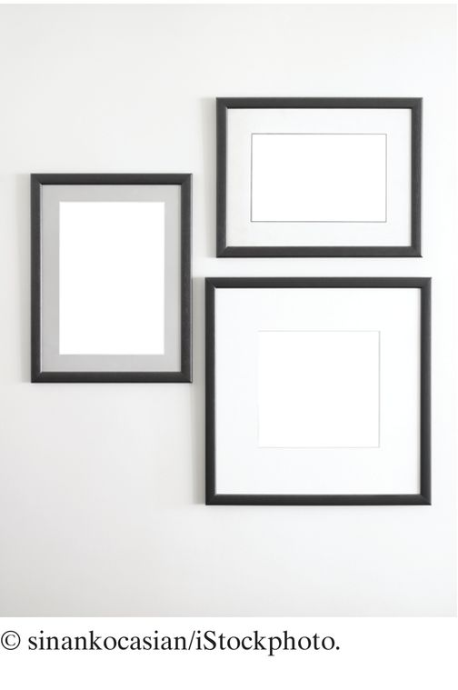
Constructing Objects
Objects of the Rectangle class describe rectangular shapes.

Slide 55
Constructing Objects
The Rectangle object is not a rectangular shape. It is an object that contains a set of numbers.
The numbers describe the rectangle
Each rectangle is described by:
The x- and y-coordinates of its top-left corner Its width
And its height.

Slide 56
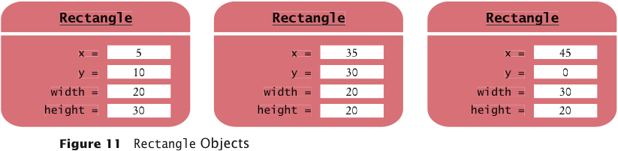
Constructing Objects
In the computer, a Rectangle object is a block of memory that holds four numbers.

Slide 57
Constructing Objects
Use the new operator, followed by a class name and arguments, to construct new objects.
new Rectangle(5, 10, 20, 30)
Detail:
The new operator makes a Rectangle object
It uses the parameters (in this case, 5, 10, 20, and 30) to initialize the data of the object
It returns the object
The process of creating a new object is called construction.
The four values 5, 10, 20, and 30 are called the construction arguments. Usually the output of the new operator is stored in a variable:
Rectangle box = new Rectangle(5, 10, 20, 30);
Additional constructor
new Rectangle()

Slide 58
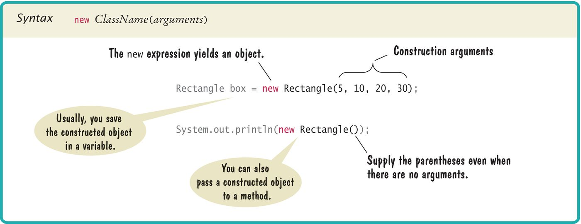
Syntax 2.3 Object Construction

Slide 59
Self Check 2.21
How do you construct a square with center (100, 100) and side length 20?
Answer:
new Rectangle(90, 90, 20, 20)

Slide 60
Self Check 2.22
Initialize the variables box and box2 with two rectangles that touch each other.
Answer:
Rectangle box = new Rectangle(5, 10, 20, 30);
Rectangle box2 = new Rectangle(25, 10, 20, 30);

Slide 61
Self Check 2.23
The getWidth method returns the width of a Rectangle object. What does the following statement print?
System.out.println(new Rectangle().getWidth());
Answer:
0

Slide 62
Self Check 2.24
The PrintStream class has a constructor whose argument is the name of a file. How do you construct a PrintStream object with the construction argument "output.txt"?
Answer: new PrintStream("output.txt");

Slide 63
Self Check 2.25
Write a statement to save the object that you constructed in Self Check 23 in a variable.
Answer: PrintStream out = new PrintStream("output.txt");

Slide 64
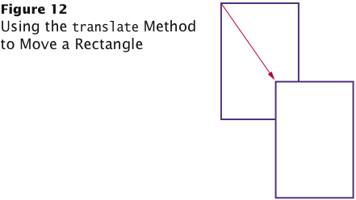
Accessor and Mutator Methods
Accessor method: does not change the internal data of the object on which it is invoked.
Returns information about the object
Example: length method of the String class Example: double width = box.getWidth();
Mutator method: changes the data of the object
box.translate(15, 25);
The top-left corner is now at (20, 35).

Slide 65
Self Check 2.26
What does this sequence of statements print?
Rectangle box = new Rectangle(5, 10, 20, 30); System.out.println("Before: " + box.getX()); box.translate(25, 40); System.out.println("After: " + box.getX());
Answer:
Before: 5
After: 30

Slide 66
Self Check 2.27
What does this sequence of statements print?
Rectangle box = new Rectangle(5, 10, 20, 30); System.out.println("Before: " + box.getWidth()); box.translate(25, 40); System.out.println("After: " + box.getWidth());
Answer:
Before: 20
After: 20
Moving the rectangle does not affect its width or height. You can change the width and height with the setSize method.

Slide 67
Self Check 2.28
What does this sequence of statements print?
String greeting = "Hello"; System.out.println(greeting.toUpperCase()); System.out.println(greeting);
Answer:
HELLO
hello
Note that calling toUpperCase doesn't modify the string.

Slide 68
Self Check 2.29
Is the toUpperCase method of the String class an accessor or a mutator?
Answer: An accessor — it doesn't modify the original string but returns a new string with uppercase letters.

Slide 69
Self Check 2.30
Which call to translate is needed to move the box rectangle so that its top-left corner is the origin (0, 0)?
Answer: box.translate(-5, -10), provided the method is called immediately after storing the new rectangle into box.

Slide 70
The API Documentation
API: Application Programming Interface
API documentation: lists classes and methods of the Java library
Application programmer: A programmer who uses the Java classes to put together a computer program (or application)
Systems Programmer: A programmer who designs and implements library classes such as PrintStream and Rectangle http://docs.oracle.com/javase/7/docs/api/index.html

Slide 71
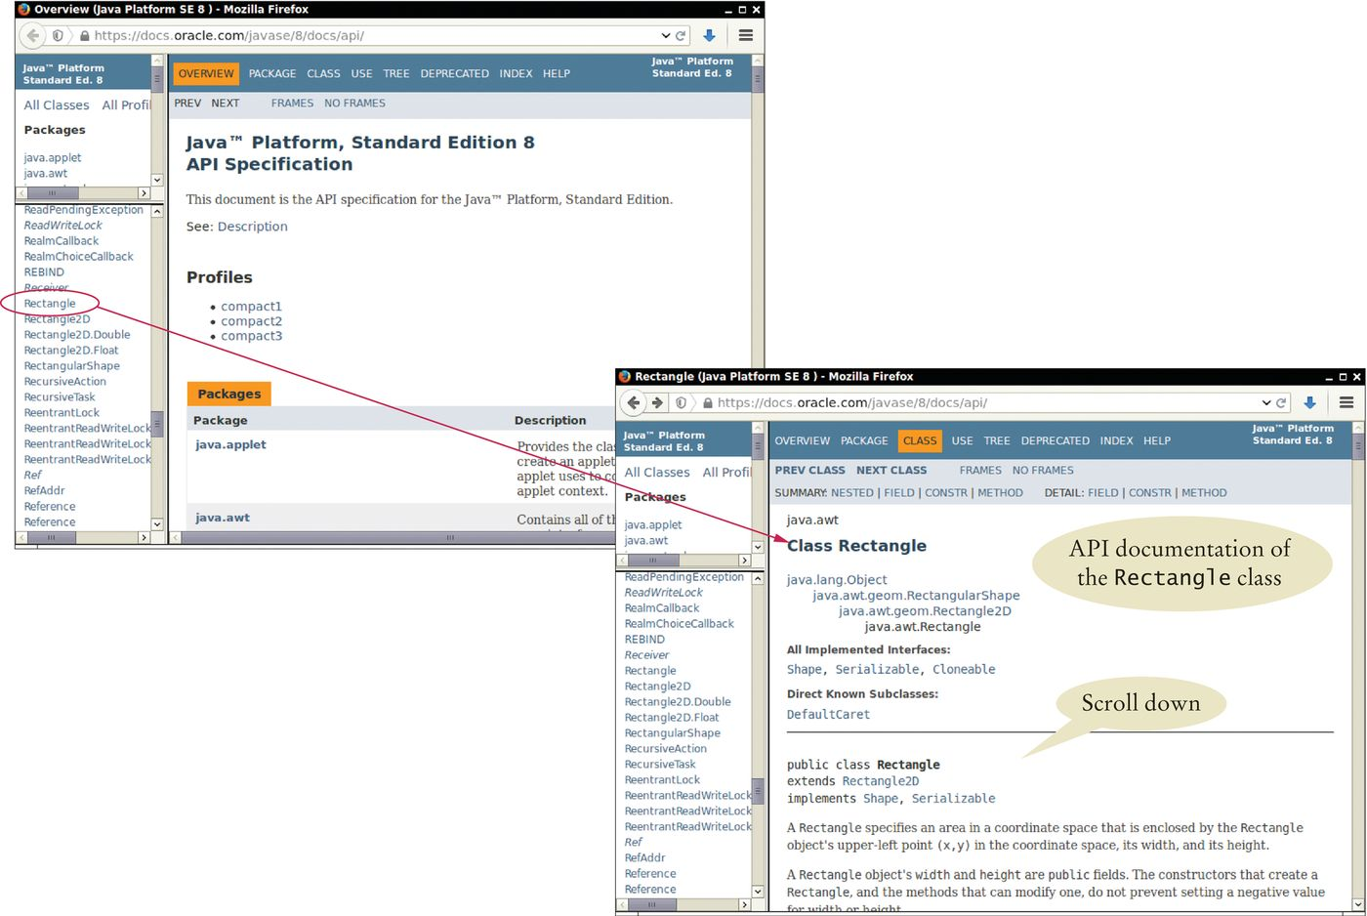
Browsing the API Documentation
Figure 13 The API Documentation of the Standard Java Library
Locate Rectangle link in the left pane Click on the link
The right pane shows all the features of the Rectangle class

Slide 72
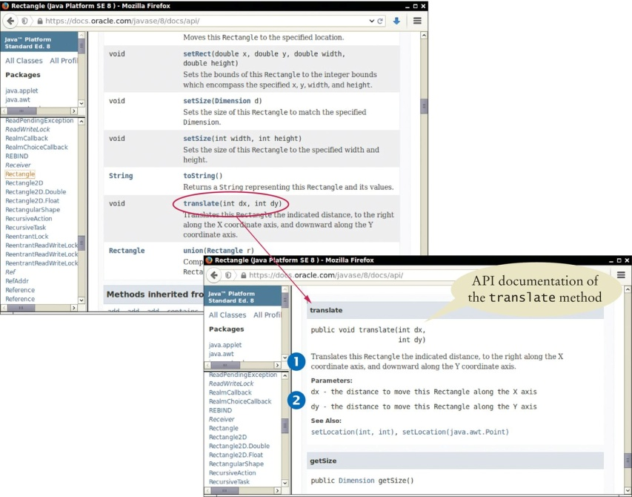
Browsing the API Documentation - Method Summary
Figure 14 The Method Summary for the Rectangle Class
The API documentation for each class has
A section that describes the purpose of the class Summary tables for the constructors and methods
Clicking on a method's link leads to a detailed description of the method

Slide 73
Browsing the API Documentation
The detailed description of a method shows:
The action that the method carries out
The types and names of the parameter variables that receive the arguments when the method is called
The value that it returns (or the reserved word void if the method doesn't return any value).

Slide 74
Packages
Java classes are grouped into packages.
The Rectangle class belongs to the package java.awt. To use the Rectangle class you must import the package:
import java.awt.Rectangle;
Put the line at the top of your program.
You don't need to import classes in the java.lang package such as
String and System.

Slide 75
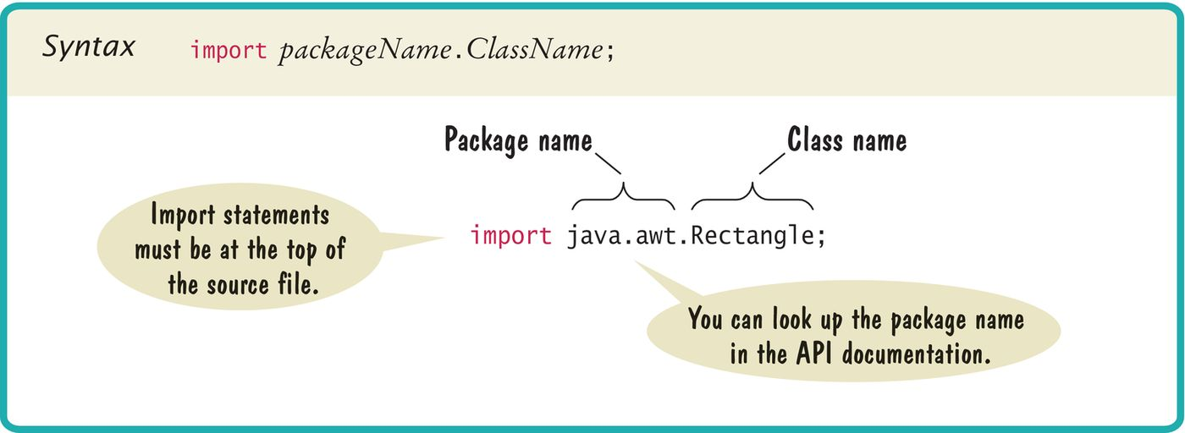
Syntax 2.4 Importing a Class from a Package

Slide 76
Self Check 2.31
Look at the API documentation of the String class. Which method would you use to obtain the string "hello, world!" from the string "Hello, World!"?
Answer: toLowerCase

Slide 77
Self Check 2.32
In the API documentation of the String class, look at the description of the trim method. What is the result of applying trim to the string " Hello, Space ! "? (Note the spaces in the string.)
Answer: "Hello, Space !" – only the leading and trailing spaces are trimmed.

Slide 78
Self Check 2.33
Look into the API documentation of the Rectangle class. What is the difference between the methods void translate(int x, int y) and void setLocation(int x, int y)?
Answer: The arguments of the translate method tell how far to move the rectangle in the x- and y-directions. The arguments of the setLocation method indicate the new x- and y-values for the top-left corner. For example, box.translate(1, 1) moves the box one pixel down and to the right. box.setLocation( 1, 1) moves box to the top-left corner of the screen.

Slide 79
Self Check 2.34
The Random class is declared in the java.util package. What do you need to do in order to use that class in your program?
Answer: Add the statement
import java.util.Random;
at the top of your program.

Slide 80
Self Check 2.35
In which package is the BigInteger class located? Look it up in the API documentation.
Answer: In the java.math package

Slide 81
Implementing a Test Program
A test program verifies that methods behave as expected. Steps in writing a tester class
Provide a tester class.
Supply a main method.
Inside the main method, construct one or more objects.
Apply methods to the objects.
Display the results of the method calls.
Display the values that you expect to get.

Slide 82
Implementing a Test Program
Code to test the behavior of the translate method
Rectangle box = new Rectangle(5, 10, 20, 30);
// Move the rectangle box.translate(15, 25);
// Print information about the moved rectangle System.out.print("x: "); System.out.println(box.getX()); System.out.println("Expected: 20");
Place the code inside the main method of the MoveTester class Determining the expected result in advance is an important part of testing.

Slide 83
section_7/MoveTester.java
1 import java.awt.Rectangle;
2
3 public class MoveTester
4 {
5 public static void main(String[] args)
6 {
7 Rectangle box = new Rectangle(5, 10, 20, 30);
8
9
10
11
12
13
14
15
16
17
18
19
20
21 }
// Move the rectangle
box.translate(15, 25);
// Print information about the moved rectangle
System.out.print("x: "); System.out.println(box.getX()); System.out.println("Expected: 20");
System.out.print("y: "); System.out.println(box.getY()); System.out.println("Expected: 35");
}
Program Run:

Slide 84
x: 20
Expected: 20
y: 35
Expected: 35

Slide 85
Self Check 2.36
Suppose we had called box.translate(25, 15) instead of box.translate(15, 25). What are the expected outputs?
Answer:
x: 30, y: 25

Slide 86
Self Check 2.37
Why doesn't the MoveTester program print the width and height of the rectangle?
Answer: Because the translate method doesn't modify the shape of the rectangle.

Slide 87
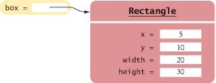
Object References
An object variable is a variable whose type is a class
Does not actually hold an object. Holds the memory location of an object
Figure 15 An Object Variable Containing an Object Reference

Slide 88
Object References
Object reference: describes the location of an object After this statement:
Rectangle box = new Rectangle(5, 10, 20, 30);
Variable box refers to the Rectangle object returned by the new operator The box variable does not contain the object. It refers to the object.

Slide 89
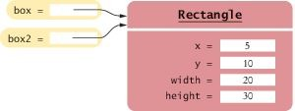
Object References
Multiple object variables can refer to the same object:
Rectangle box = new Rectangle(5, 10, 20, 30); Rectangle box2 = box;
Figure 16 Two Object Variables Referring to the Same Object

Slide 90
Numbers
Numbers are not objects.
Number variables actually store numbers.
Figure 17 A Number Variable Stores a Number

Slide 91
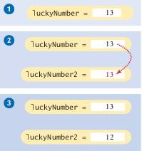
Copying Numbers
When you copy a number
the original and the copy of the number are independent values.
int luckyNumber = 13;
int luckyNumber2 = luckyNumber; luckyNumber2 = 12;
Figure 18 Copying Numbers

Slide 92
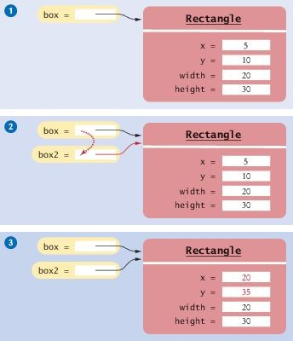
Copying Object References
When you copy an object reference
both the original and the copy are references to the same object
Rectangle box = new Rectangle(5, 10, 20, 30); Rectangle box2 = box;
box2.translate(15, 25);
Figure 19 Copying Object References

Slide 93
Self Check 2.38
What is the effect of the assignment greeting2 = greeting?
Answer: Now greeting and greeting2 both refer to the same String
object.

Slide 94
Self Check 2.39
After calling greeting2.toUpperCase(), what are the contents of greeting and
greeting2?
Answer: Both variables still refer to the same string, and the string has not been modified. Recall that the toUpperCase method constructs a new string that contains uppercase characters, leaving the original string unchanged.

Slide 95
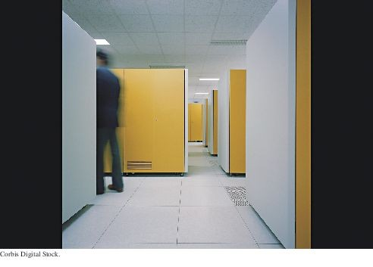
Mainframe Computer
Mainframe Computer

Slide 96

Graphical Applications: Frame Windows
A graphical application shows information inside a frame.

Slide 97
Frame Windows
To show a frame:
1. Construct an object of the JFrame class:
JFrame frame = new JFrame();
2. Set the size of the frame:
frame.setSize(300, 400);
3. If you'd like, set the title of the frame:
frame.setTitle("An empty Frame");
4. Set the "default close operation":
frame.setDefaultCloseOperation(JFrame.EXIT_ON_CLOSE);
5. Make the frame visible:
frame.setVisible(true);

Slide 98
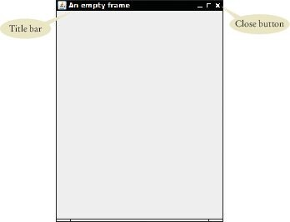
section_9_1/EmptyFrameViewer.java
1 import javax.swing.JFrame;
2
3 public class EmptyFrameViewer
4 {
5 public static void main(String[] args)
6 {
JFrame frame = new JFrame();
frame.setSize(300, 400);
frame.setTitle("An empty frame");
frame.setDefaultCloseOperation(JFrame.EXIT_ON_CLOSE);
frame.setVisible(true);
12 }
13 }
Figure 20 A Frame Window

Slide 99
Drawing on a Component
In order to display a drawing in a frame, define a class that extends the
JComponent class.
Place drawing instructions inside the paintComponent method.
That method is called whenever the component needs to be repainted:
public class RectangleComponent extends JComponent
{
public void paintComponent(Graphics g)
{
Drawing instructions go here
}
}

Slide 100
Classes Graphics and Graphics2D
Graphics class stores the graphics state (such as current color).
Graphics2D class has methods to draw shape objects.
Use a cast to recover the Graphics2D object from the Graphics
parameter:
public class RectangleComponent extends JComponent
{
public void paintComponent(Graphics g)
{
// Recover Graphics2D Graphics2D g2 = (Graphics2D) g;
. . .
}
}

Slide 101
Classes Graphics and Graphics2D
The draw method of the Graphics2D class draws shapes, such as rectangles, ellipses, line segments, polygons, and arcs:
public class RectangleComponent extends JComponent
{
public void paintComponent(Graphics g)
{
. . .
Rectangle box = new Rectangle(5, 10, 20, 30); g2.draw(box);
. . .
}
}

Slide 102
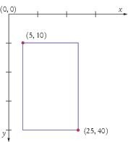
Coordinate System of a Component
The origin (0, 0) is at the upper-left corner of the component. The y-coordinate grows downward.

Slide 103
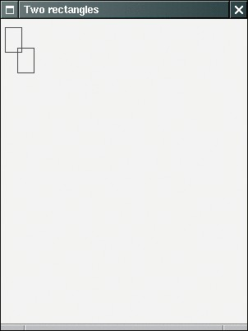
Drawing Rectangles
We want to create an application to display two rectangles.
Figure 2 Drawing Rectangles

Slide 104
section_9_2/RectangleComponent.java
import java.awt.Graphics;
import java.awt.Graphics2D;
import java.awt.Rectangle;
import javax.swing.JComponent;
5
6 /*
7
8
9
10
11
12
13
14
15
16
17
18
19
20
21
22
23
24
25
26 }
A component that draws two rectangles.
*/
public class RectangleComponent extends JComponent
{
public void paintComponent(Graphics g)
{
// Recover Graphics2D
Graphics2D g2 = (Graphics2D) g;
// Construct a rectangle and draw it
Rectangle box = new Rectangle(5, 10, 20, 30); g2.draw(box);
// Move rectangle 15 units to the right and 25 units down
box.translate(15, 25);
// Draw moved rectangle
g2.draw(box);
}

Slide 105
Displaying a Component in a Frame
In a graphical application you need:
A frame to show the application A component for the drawing.
The steps for combining the two:
Construct a frame object and configure it.
Construct an object of your component class:
RectangleComponent component = new RectangleComponent();
3. Add the component to the frame:
frame.add(component);
4. Make the frame visible.

Slide 106
section_9_3/RectangleViewer.java
1 import javax.swing.JFrame;
2
3 public class RectangleViewer
4 {
5 public static void main(String[] args)
6 {
7 JFrame frame = new JFrame();
8
9
10
11
12
13
14
15
16
17
18 }
frame.setSize(300, 400); frame.setTitle("Two rectangles");
frame.setDefaultCloseOperation(JFrame.EXIT_ON_CLOSE);
RectangleComponent component = new RectangleComponent(); frame.add(component);
frame.setVisible(true);
}

Slide 107
Self Check 2.40
How do you display a square frame with a title bar that reads "Hello, World!"?
Answer: Modify the EmptyFrameViewer program as follows:
frame.setSize(300, 300); frame.setTitle("Hello, World!");

Slide 108
Self Check 2.41
How can a program display two frames at once?
Answer: Construct two JFrame objects, set each of their sizes, and call
setVisible(true) on each of them.

Slide 109
Self Check 2.42
How do you modify the program to draw two squares?
Answer: Rectangle box = new Rectangle(5, 10, 20, 20);

Slide 110
Self Check 2.43
How do you modify the program to draw one rectangle and one square?
Answer: Replace the call to box.translate(15, 25) with
box = new Rectangle(20, 35, 20, 20);

Slide 111
Self Check 2.44
What happens if you call g.draw(box) instead of g2.draw(box)?
Answer: The compiler complains that g doesn't have a draw method.

Slide 112
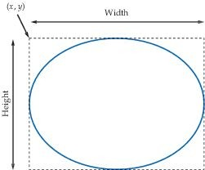
Ellipses
To construct an ellipse, you specify its bounding box.
Figure 22 An Ellipse and Its Bounding Box
To construct an Ellipse:
Ellipse2D.Double ellipse = new Ellipse2D.Double(x, y, width, height);

Slide 113
Ellipses
Ellipse2D.Double is an inner class — doesn't matter to us except for the import statement:
import java.awt.geom.Ellipse2D; // No .Double
To draw the shape:
g2.draw(ellipse);

Slide 114
Circles
To draw a circle, set the width and height to the same values:
Ellipse2D.Double circle = new Ellipse2D.Double(x, y, diameter, diameter); g2.draw(circle);
(x, y) is the top-left corner of the bounding box, not the center of the circle.

Slide 115
Lines
To draw a line, specify its end points:
Line2D.Double segment = new Line2D.Double(x1, y1, x2, y2); g2.draw(segment);
or
Point2D.Double from = new Point2D.Double(x1, y1); Point2D.Double to = new Point2D.Double(x2, y2); Line2D.Double segment = new Line2D.Double(from, to); g2.draw(segment);

Slide 116

Drawing Text
To draw text, use the drawString method
Specify the string and the x- and y-coordinates of the basepoint of the first character
g2.drawString("Message", 50, 100);
Figure 23 Basepoint and Baseline

Slide 117
Colors
To draw in color, you need to supply a Color object.
Specify the amount of red, green, blue as values between 0 and 255:
Color magenta = new Color(255, 0, 255);
The Color class declares a variety of colors:
Color.BLUE, Color.RED, Color.PINK etc.
To draw a shape in a different color
First set color in graphics context:
g2.setColor(Color.Red);
g2.draw(circle); // Draws the shape in red

Slide 118
Colors - continued
To color the inside of the shape, use the fill method:
g2.fill(circle); // Fills with current color
When you set a new color in the graphics context, it is used for subsequent drawing operations.

Slide 119
Predefined Colors
Color
RGB Value
Color.BLACK
0, 0, 0
Color.BLUE
0, 0, 255
Color.CYAN
0, 255, 255
Color.GRAY
128, 128, 128
Color.DARK_GRAY
64, 64, 64
Color.LIGHT_GRAY
192, 192, 192
Color.GREEN
0, 255, 0
Color.MAGENTA
255, 0, 255
Color.ORANGE
255, 200, 0
Color.PINK
255, 175, 175
Color.RED
255, 0, 0
Color.WHITE
255, 255, 255
Color.YELLOW
255, 255, 0

Slide 120
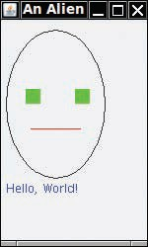
Alien Face
Figure 24 An Alien Face
The code is on following slides:

Slide 121
section_10/FaceComponent.java
import java.awt.Color;
import java.awt.Graphics;
import java.awt.Graphics2D;
import java.awt.Rectangle;
import java.awt.geom.Ellipse2D;
import java.awt.geom.Line2D;
import javax.swing.JComponent;
8
9 /*
10
11
12
13
14
15
16
17
18
19
20
21
22
23
24
25
26
27
28
29
30
31
32
33
34
35
A component that draws an alien face
*/
public class FaceComponent extends JComponent
{
public void paintComponent(Graphics g)
{
// Recover Graphics2D
Graphics2D g2 = (Graphics2D) g;
// Draw the head
Ellipse2D.Double head = new Ellipse2D.Double(5, 10, 100, 150); g2.draw(head);
// Draw the eyes
g2.setColor(Color.GREEN);
Rectangle eye = new Rectangle(25, 70, 15, 15); g2.fill(eye);
eye.translate(50, 0); g2.fill(eye);
// Draw the mouth
Line2D.Double mouth = new Line2D.Double(30, 110, 80, 110); g2.setColor(Color.RED);
g2.draw(mouth);
// Draw the greeting

Slide 122
section_10/FaceViewer.java
1 import javax.swing.JFrame;
2
3 public class FaceViewer
4 {
5 public static void main(String[] args)
6 {
JFrame frame = new JFrame();
frame.setSize(150, 250);
frame.setTitle("An Alien Face");
frame.setDefaultCloseOperation(JFrame.EXIT_ON_CLOSE);
11
12
13
14
15
16
17 }
FaceComponent component = new FaceComponent(); frame.add(component);
frame.setVisible(true);
}

Slide 123
Self Check 2.45
Give instructions to draw a circle with center (100, 100) and radius 25.
Answer:
g2.draw(new Ellipse2D.Double(75, 75, 50, 50));

Slide 124
Self Check 2.46
Give instructions to draw a letter "V" by drawing two line segments.
Answer:
Line2D.Double segment1 = new Line2D.Double(0, 0, 10, 30); g2.draw(segment1);
Line2D.Double segment2 = new Line2D.Double(10, 30, 20, 0); g2.draw(segment2);

Slide 125
Self Check 2.47
Give instructions to draw a string consisting of the letter "V".
Answer:
g2.drawString("V", 0, 30);

Slide 126
Self Check 2.48
What are the RGB color values of Color.BLUE?
Answer: 0, 0, and 255

Slide 127
Self Check 2.49
How do you draw a yellow square on a red background?
Answer: First fill a big red square, then fill a small yellow square inside:
g2.setColor(Color.RED);
g2.fill(new Rectangle(0, 0, 200, 200)); g2.setColor(Color.YELLOW);
g2.fill(new Rectangle(50, 50, 100, 100));

